Slide 1
BANK LOAN ANALYSIS
Ayush Saxena

Slide 2
PROJECT DESCRIPTION:
The project is all about carrying out an exploratory data analysis EDA for the banking sector. In this, we are going to consider the different types of EDA as univariate, bivariate, and multivariate analysis to carry out the analysis and help them to understand the solution to the problem statement.
This case study aims to give an idea of applying EDA in a real business scenario. In this case study, apart from applying the techniques that we have learned in the EDA module, we will also develop a basic understanding of risk analytics in banking and financial services and understand how data is used to minimize the risk of losing money while lending to customers.

Slide 3
APPROACH:
My first approach to solve this case study is to go through the dataset and analyze the dataset afterward I clean the dataset finding the blanks and missing values and imputing the missing values with the appropriate method(mean, median, mode). Then I tried to find the outliers in the dataset and analyze the outliers by using a boxplot After all this, I used pivot tables and basic charts to visualize the data. After completing all the steps, I walk through the question that has been asked by the team.
TechStack:
(Python Jupyter Notebook),(Microsoft Excel),(Microsoft PowerPoint)

Slide 4
Business Understanding:
The loan-providing companies find it hard to give loans to people due to their insufficient or non-existent credit history. Because of that, some consumers use it to their advantage by becoming defaulters. Suppose we work for a consumer finance company specializing in lending various loans to urban customers. We have to use EDA to analyze the patterns present in the data. This will ensure that the applicants capable of repaying the loan are not rejected.
When the company receives a loan application, the company has to decide on loan approval based on the applicant’s profile. Two types of risks are associated with the bank’s decision:
If the applicant is likely to repay the loan, then not approving the loan results in a loss of business to the company.
If the applicant is not likely to repay the loan, i.e he/she is likely to default, then approving the loan may lead to a financial loss for the company.

Slide 5
Business Insights:
When a client applies for a loan, there are four types of decisions that could be taken by the client/company:
Approved: The company has approved the loan application
Cancelled: The client cancelled the application sometime during approval. Either the client changed her/his mind about the loan or in some cases due to a higher risk the client received worse pricing which he did not want.
Refused: The company had rejected the loan (because the client does not meet their requirements etc.).
Unused Offer: The client has cancelled the loan but on different stages of the process.
In this case study, we will use EDA to understand how consumer attributes and loan attributes influence the tendency of default.

Slide 6
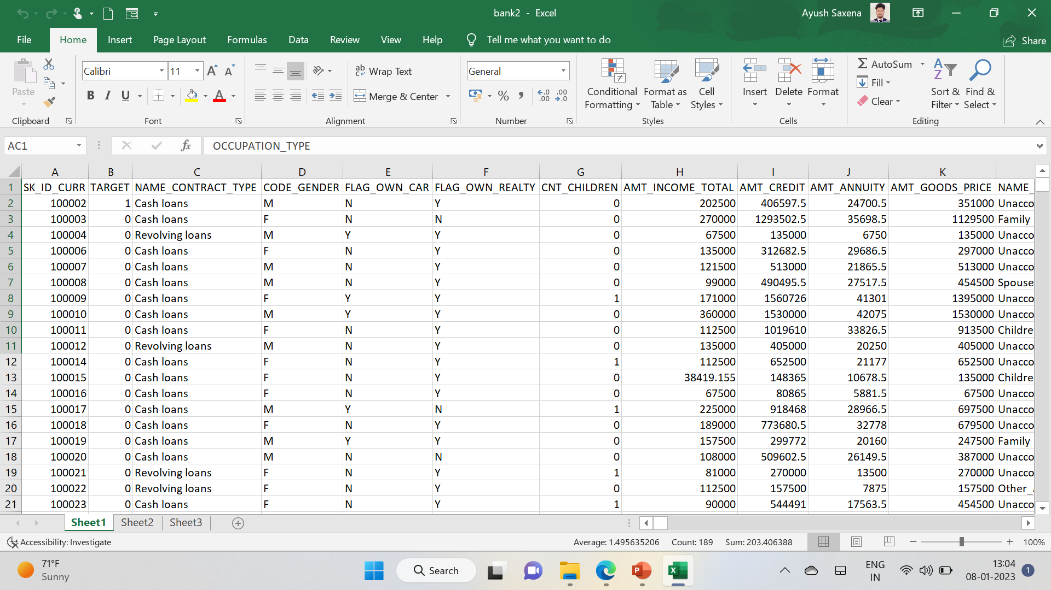
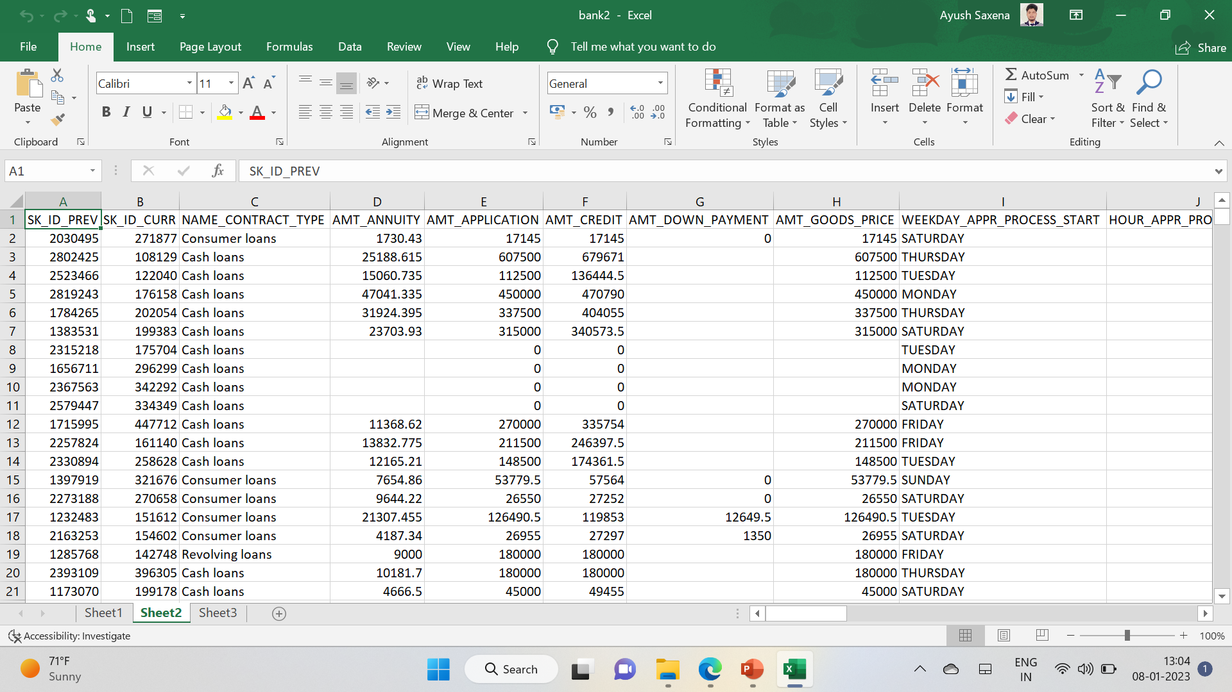
Types of data tables
application_data
previous_application

Slide 7
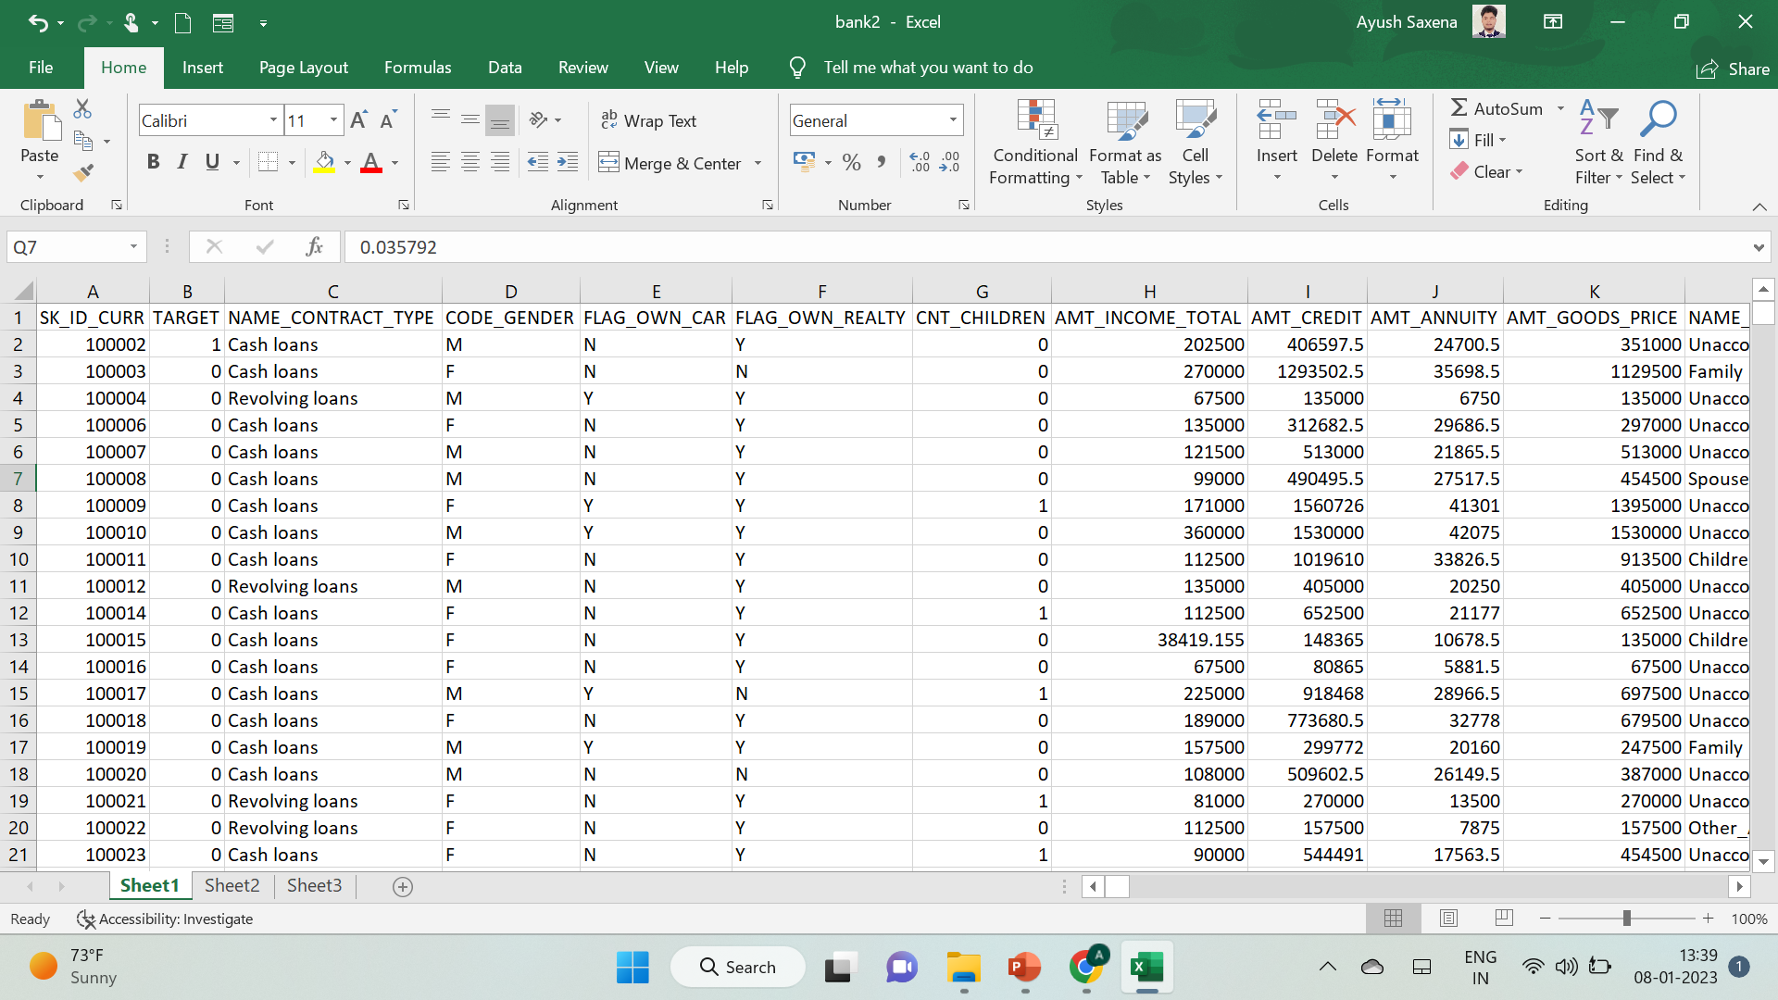
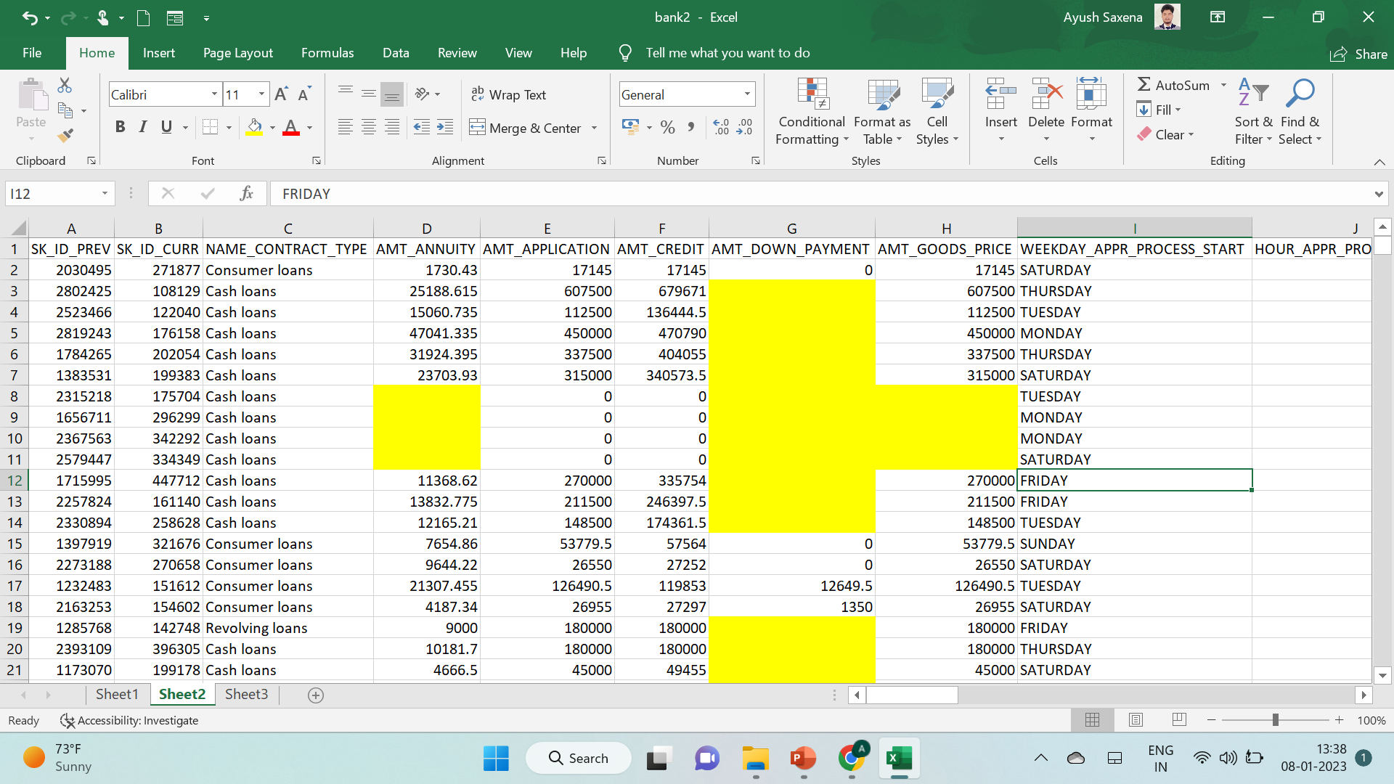
By this, we have highlighted the blank cell
application_data
previous_application

Slide 8
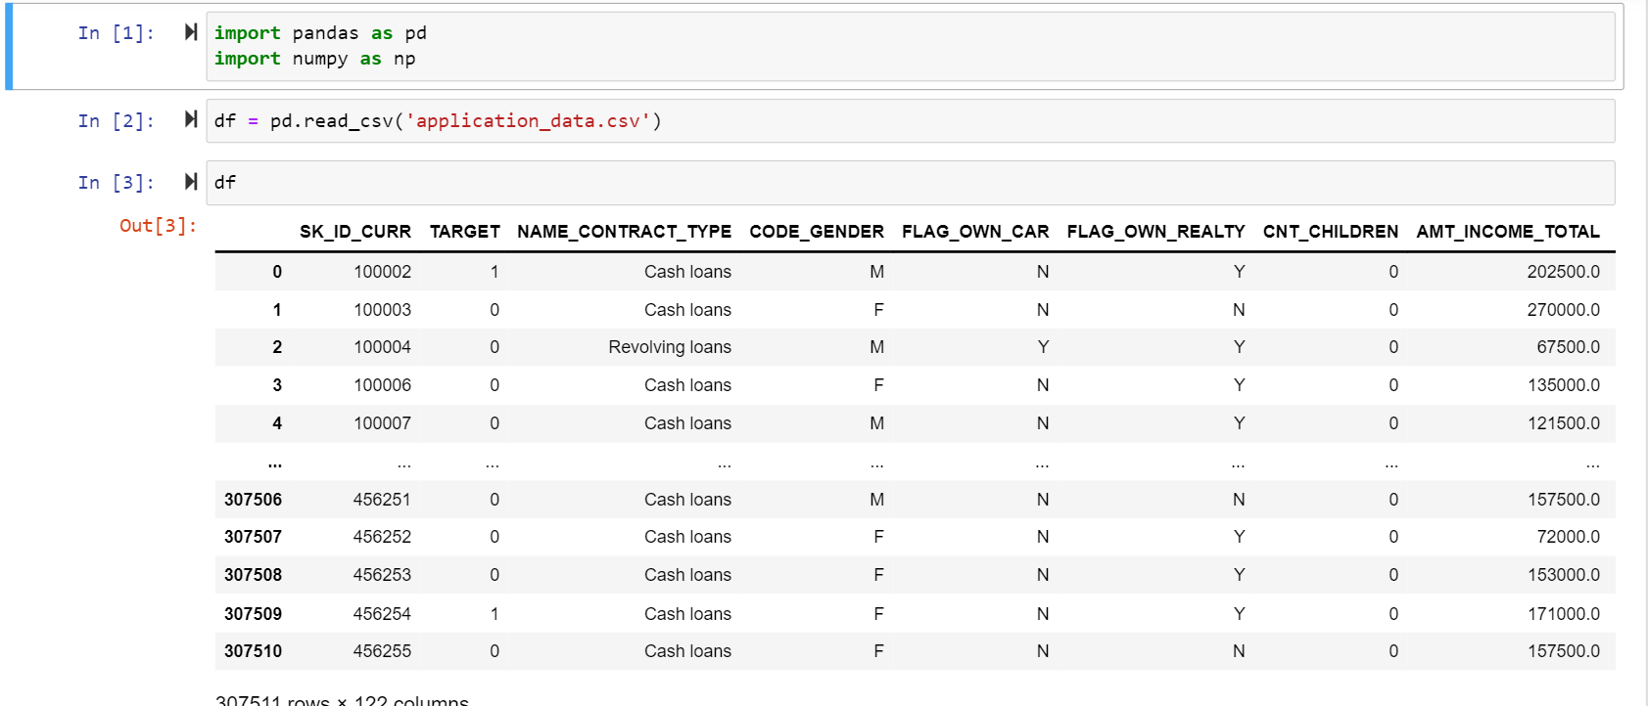
Identify the missing data and use an appropriate method to deal with it. (Remove columns/or replace them with an appropriate value)

Slide 9
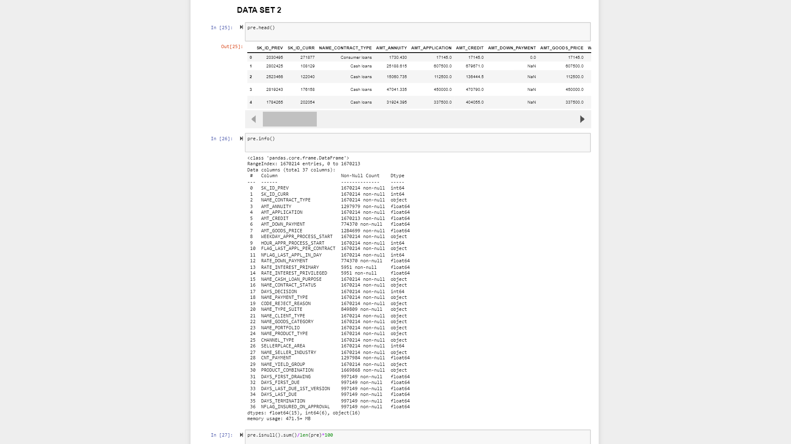
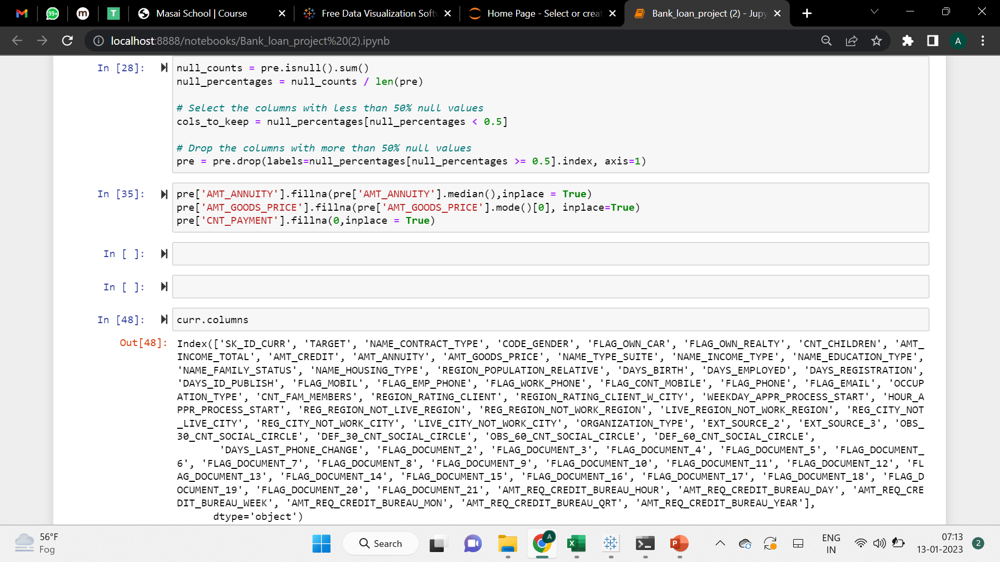

Slide 10
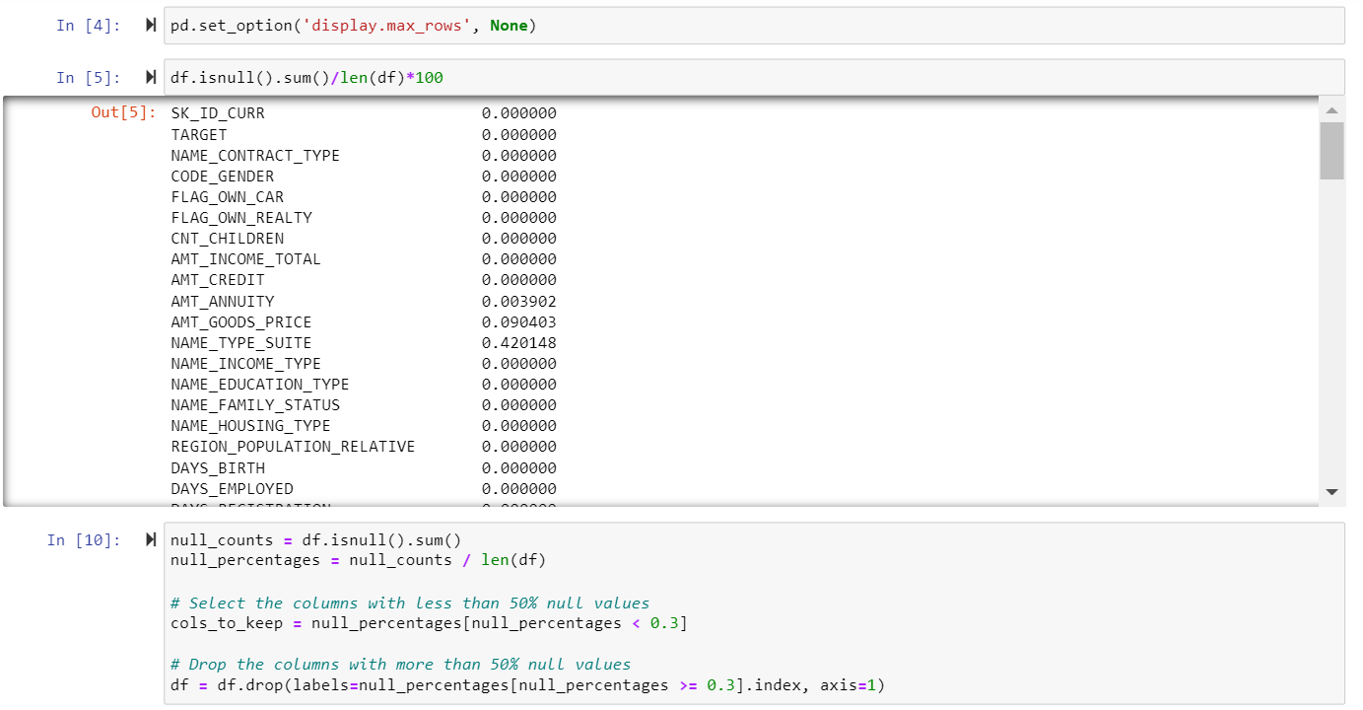
As the EDA part can also be done by python so for data cleaning first I tried excel but as the data is too big so I tried python for further project

Slide 11
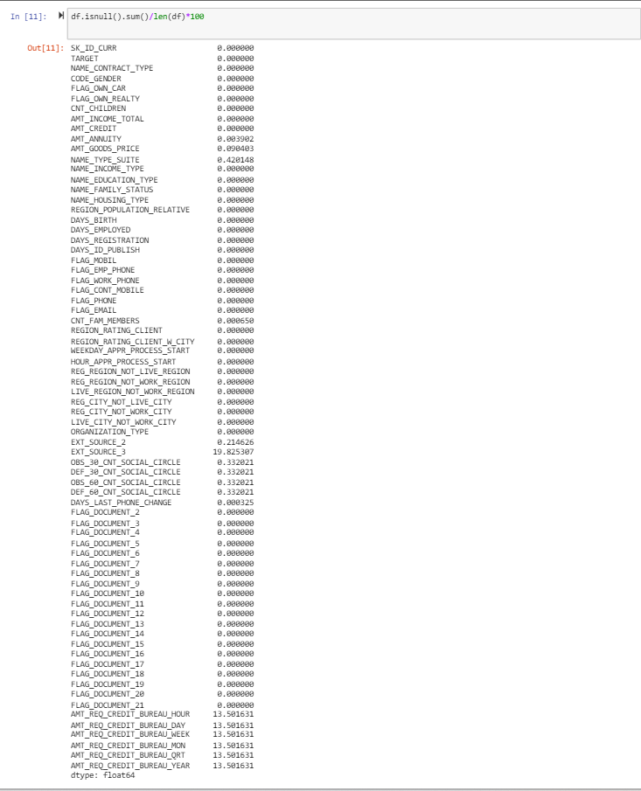
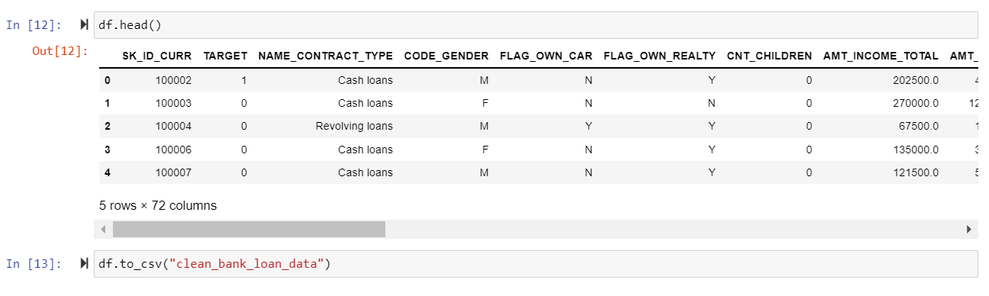

Slide 12
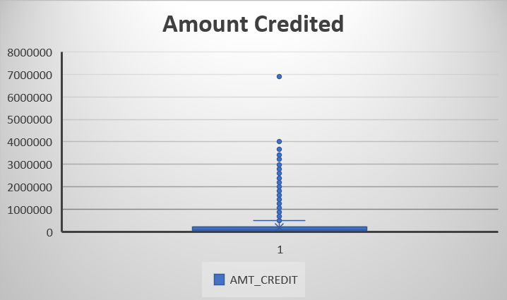
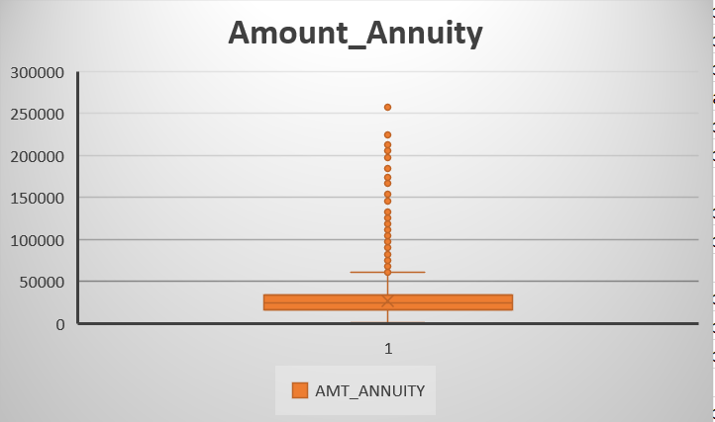
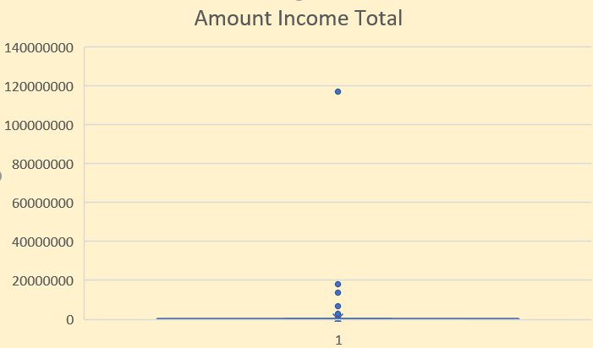
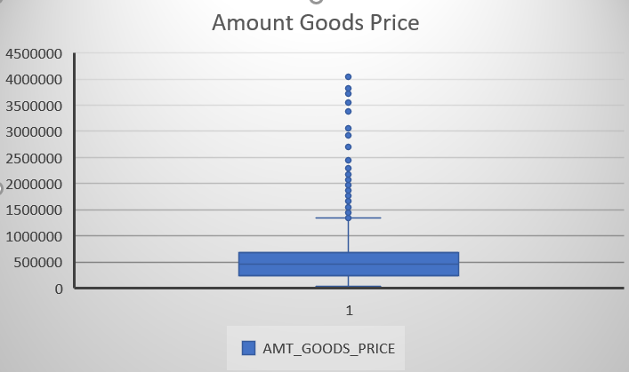
Identify if there are outliers in the dataset. Also, mention why you think it is an outlier. Again, remember that for this exercise, it is not necessary to remove any data points. Since there are so many columns, so we have seen some of the column's outliers.

Slide 13
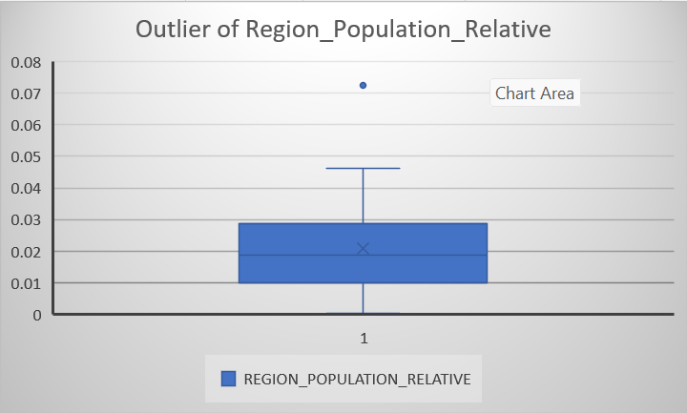
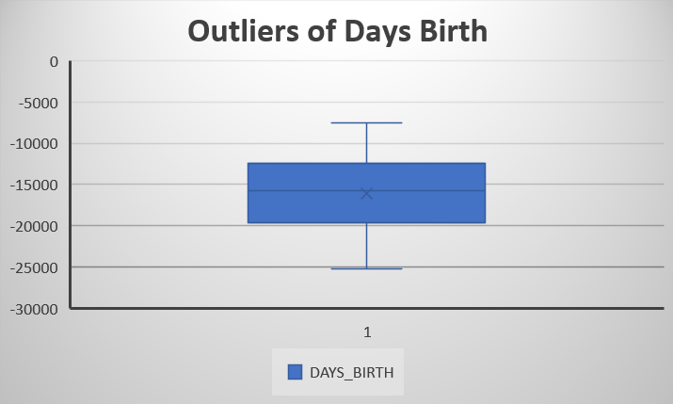
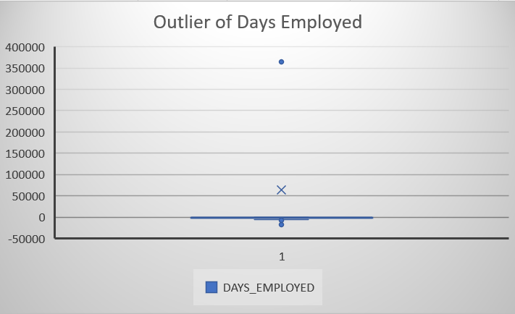
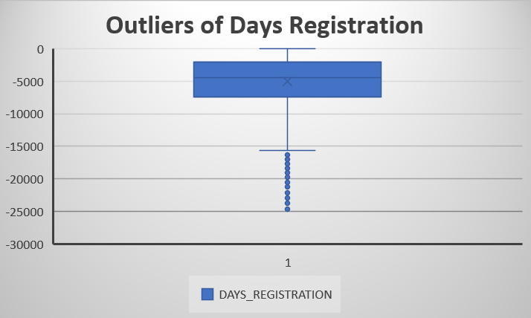

Slide 14
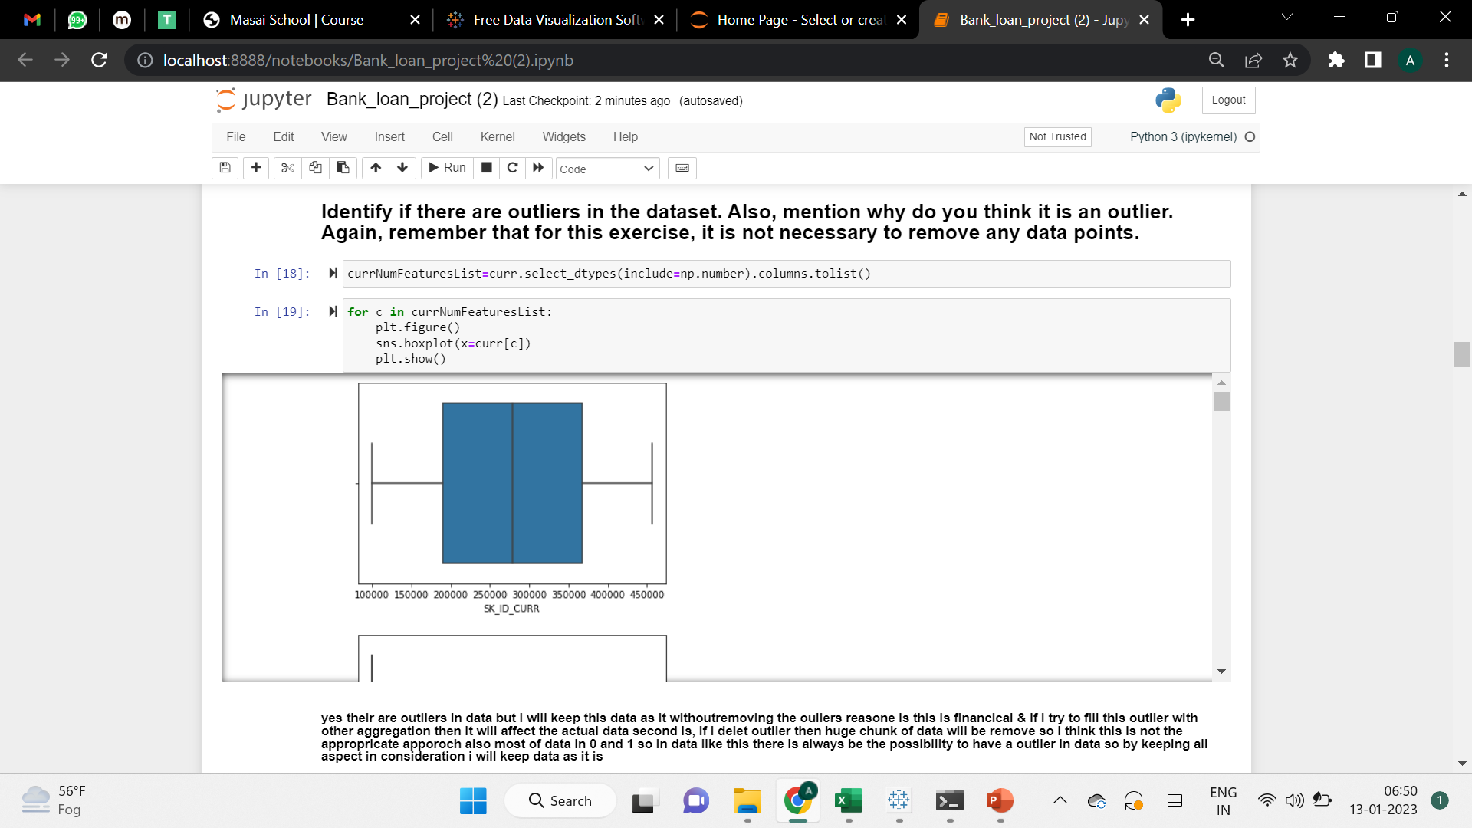
Identify if there are outliers in the dataset. Also, mention why you think it is an outlier. Again, remember that for this exercise, it is not necessary to remove any data points. Since there are so many columns, so we have seen some of the column's outliers.

Slide 15
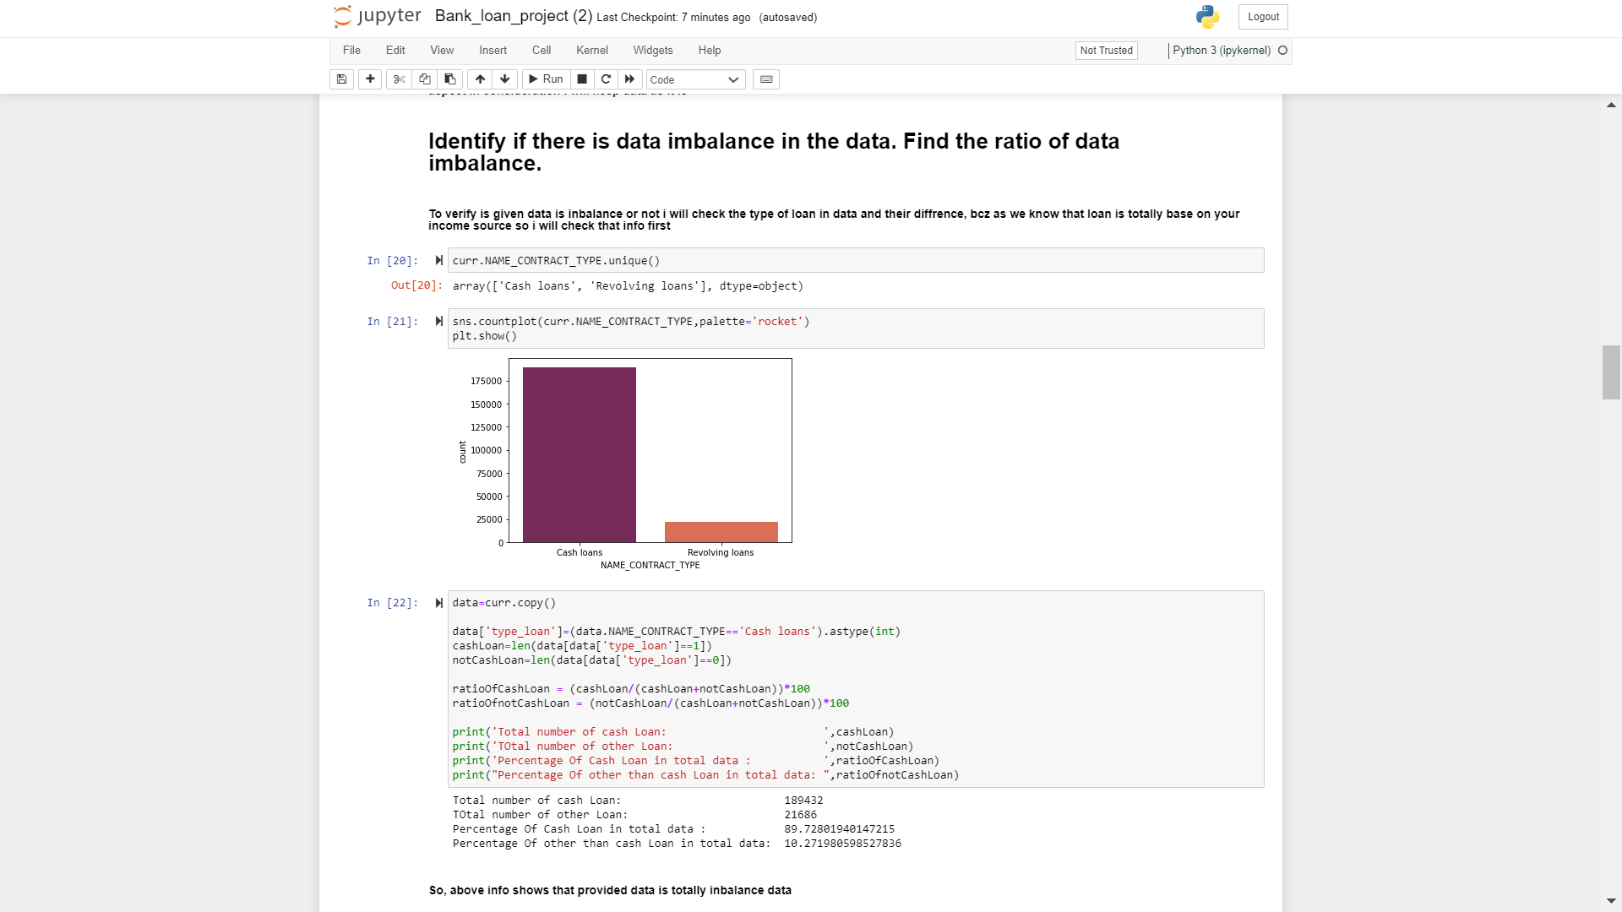
Identify if there is a data imbalance in the data. Find the ratio of data imbalance.

Slide 16
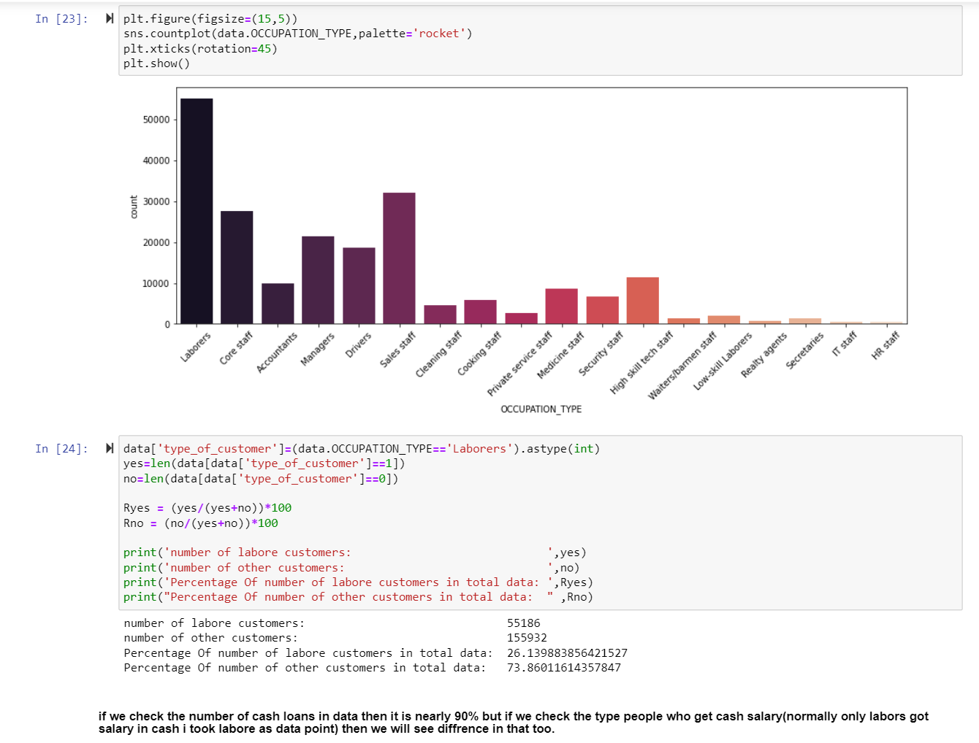

Slide 17
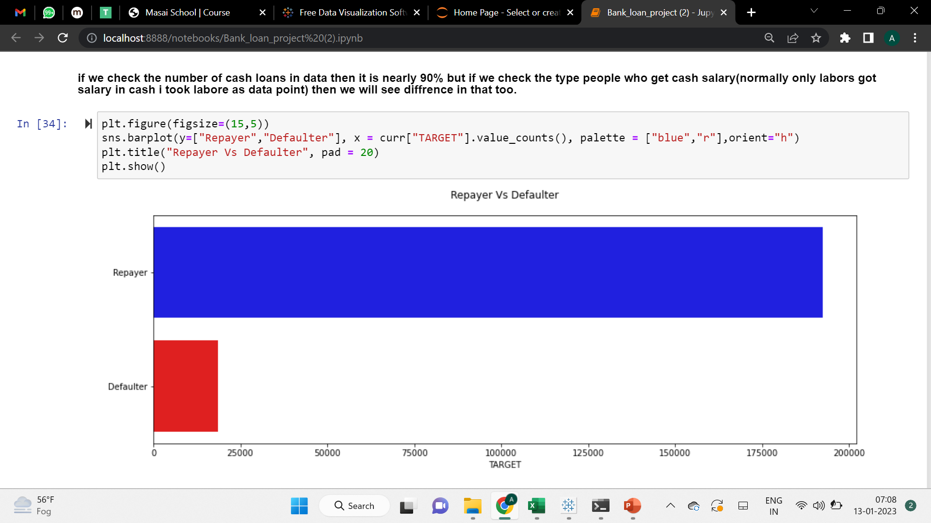

Slide 18
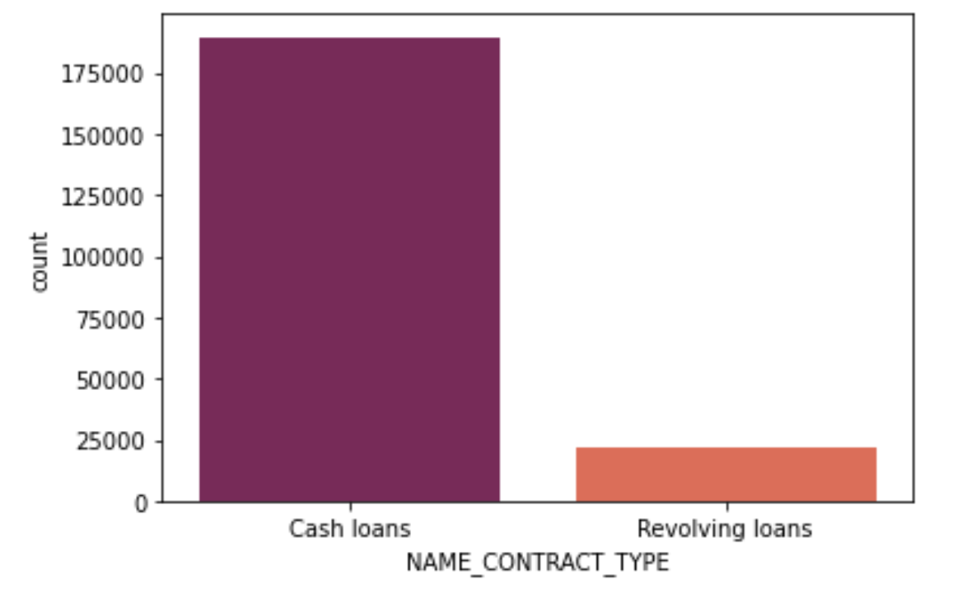
Data Imbalance Graph

Slide 19
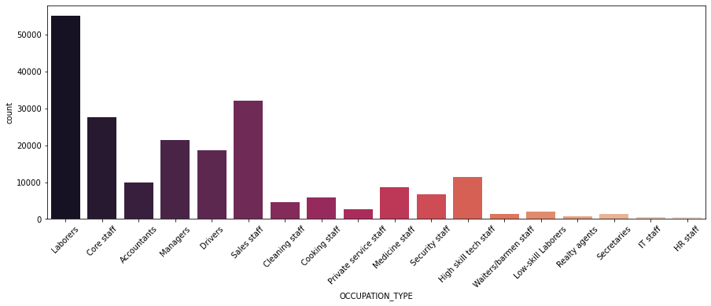
Occupation Type Graph

Slide 20
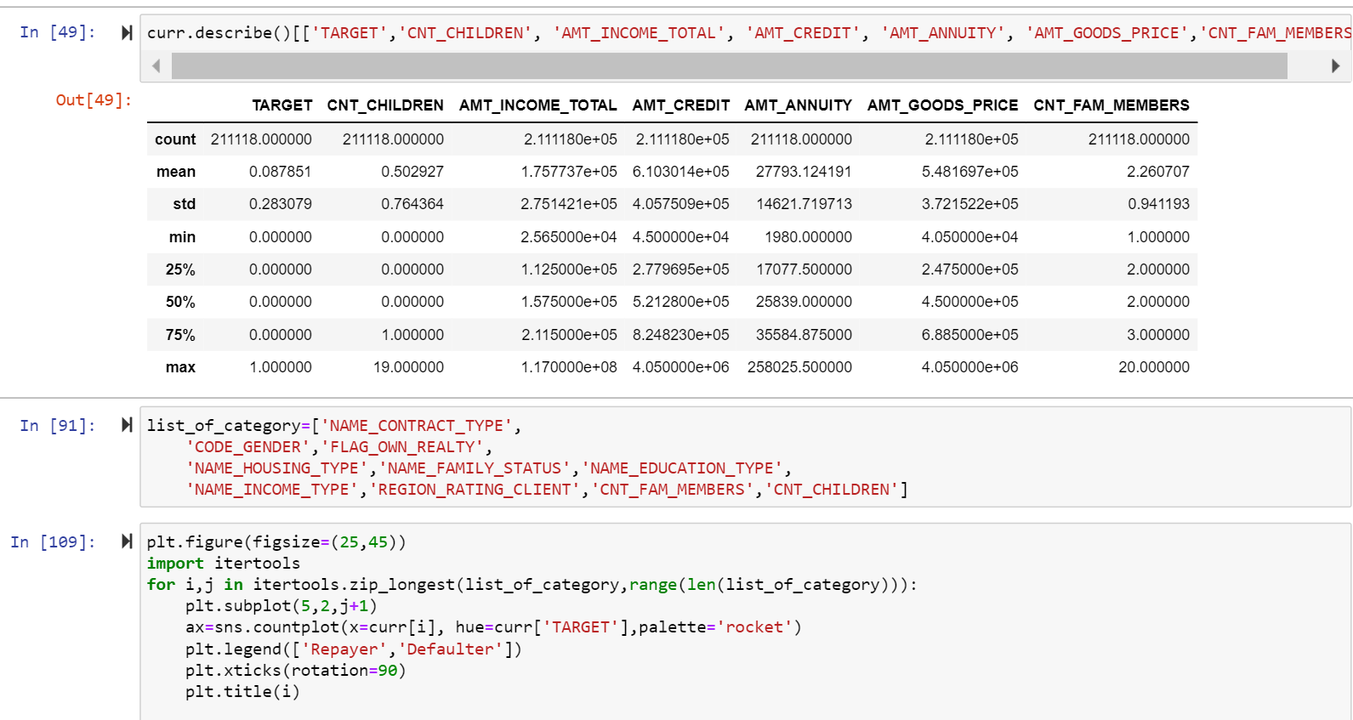
Explain the results of univariate, segmented univariate, bivariate analysis, etc. in business terms.

Slide 21
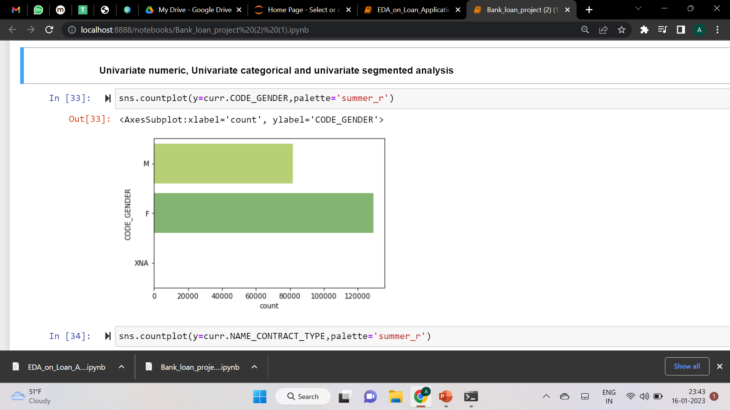
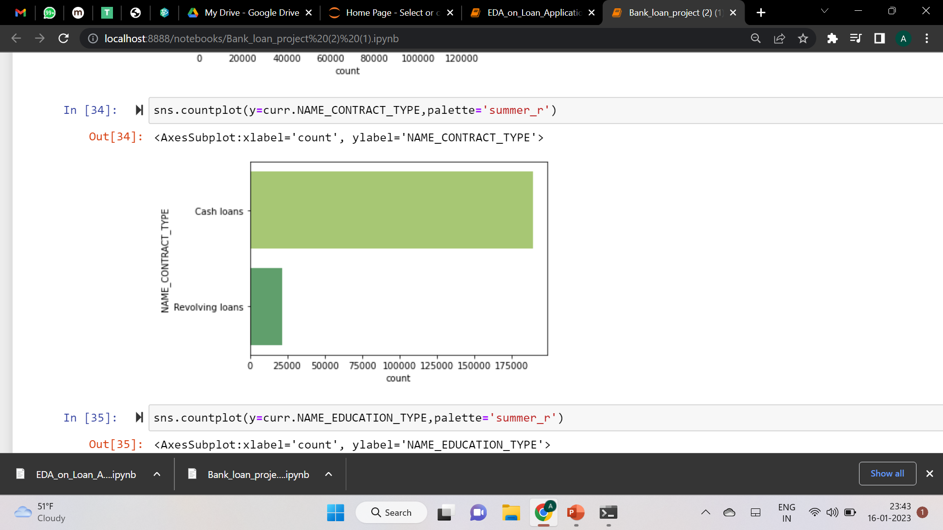
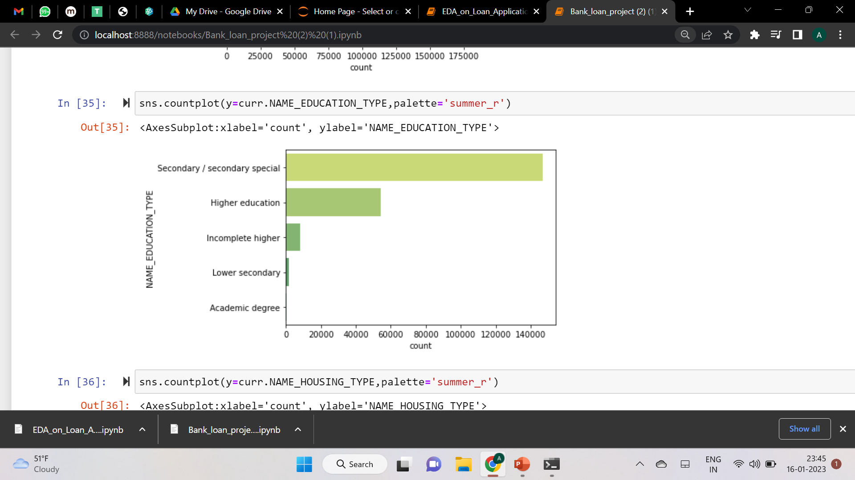
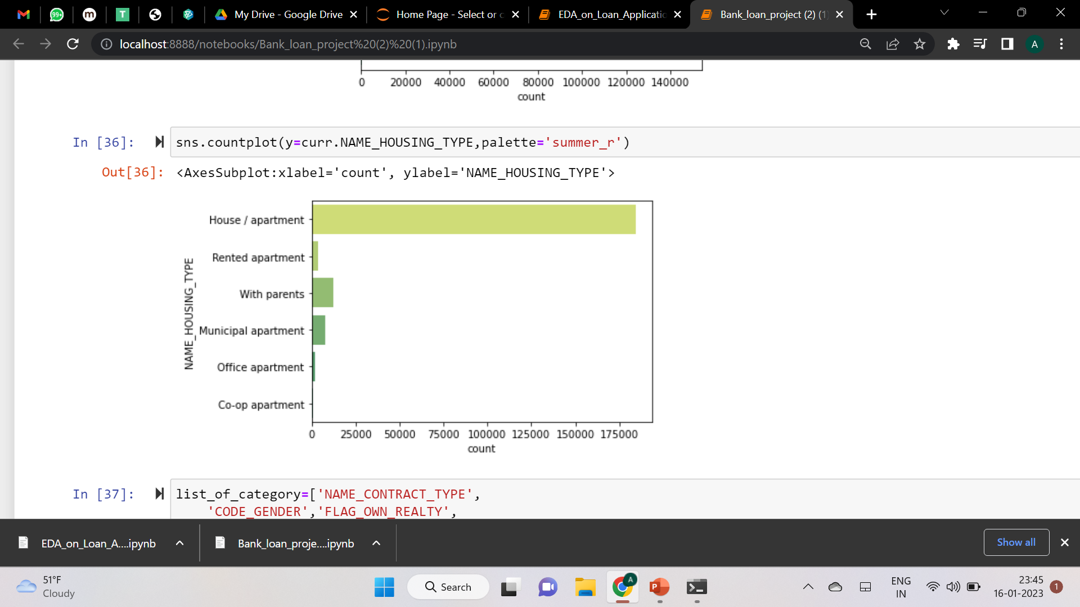

Slide 22
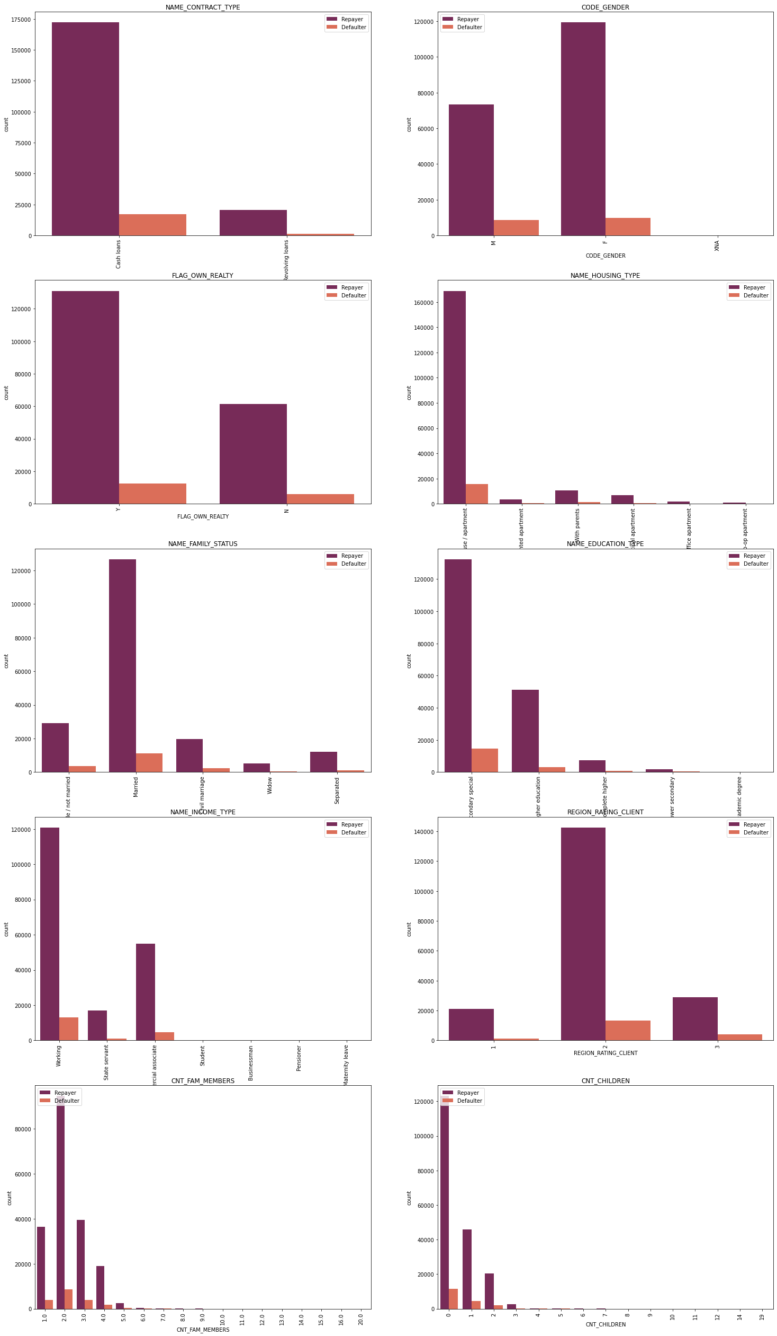
Visualization of results of univariate, segmented univariate, bivariate analysis, etc. in business terms.

Slide 23
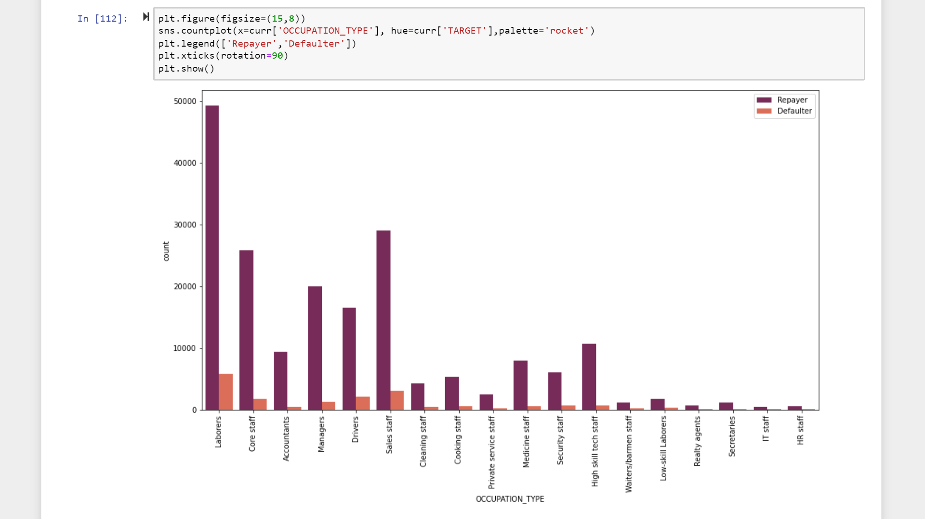

Slide 24
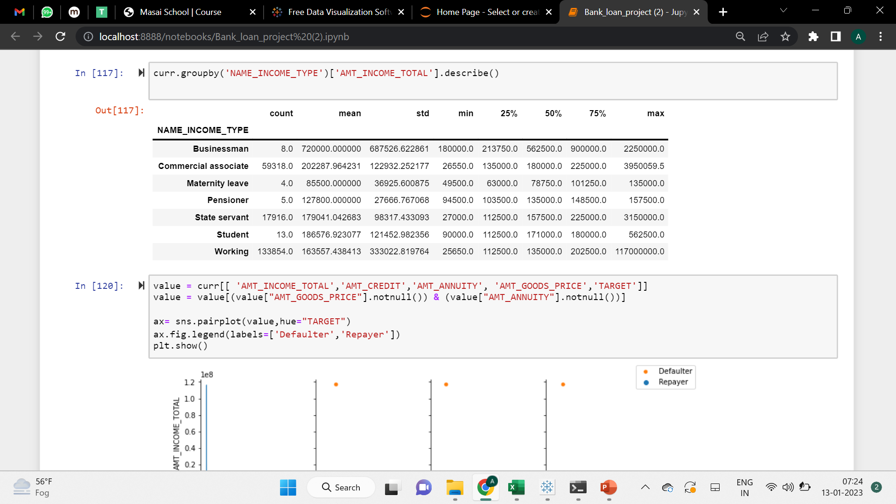
Bivariate analysis

Slide 25
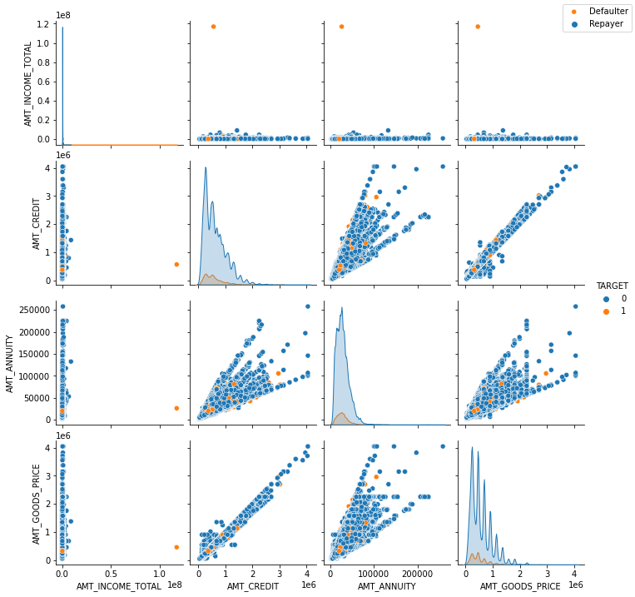

Slide 26
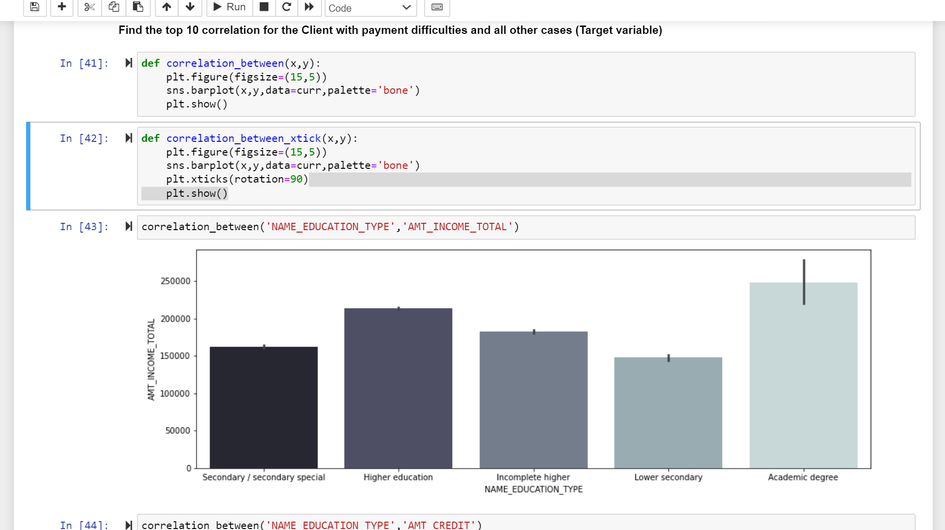
Find the top 10 correlations for the Client with payment difficulties and all other cases (Target variable). Note that you must find the top correlation by segmenting the data frame w.r.t to the target variable and then find the top correlation for each of the segmented data and find if any insight is there. Say, there are 5+1(target) variables in a dataset: Var1, Var2, Var3, Var4, Var5, Target. And if you must find the top 3 correlations, it can be Var1 & Var2, Var2 & Var3, Var1 & Var3. The target variable will not feature in this correlation as it is a categorical variable and not a continuous variable that is increasing or decreasing

Slide 27
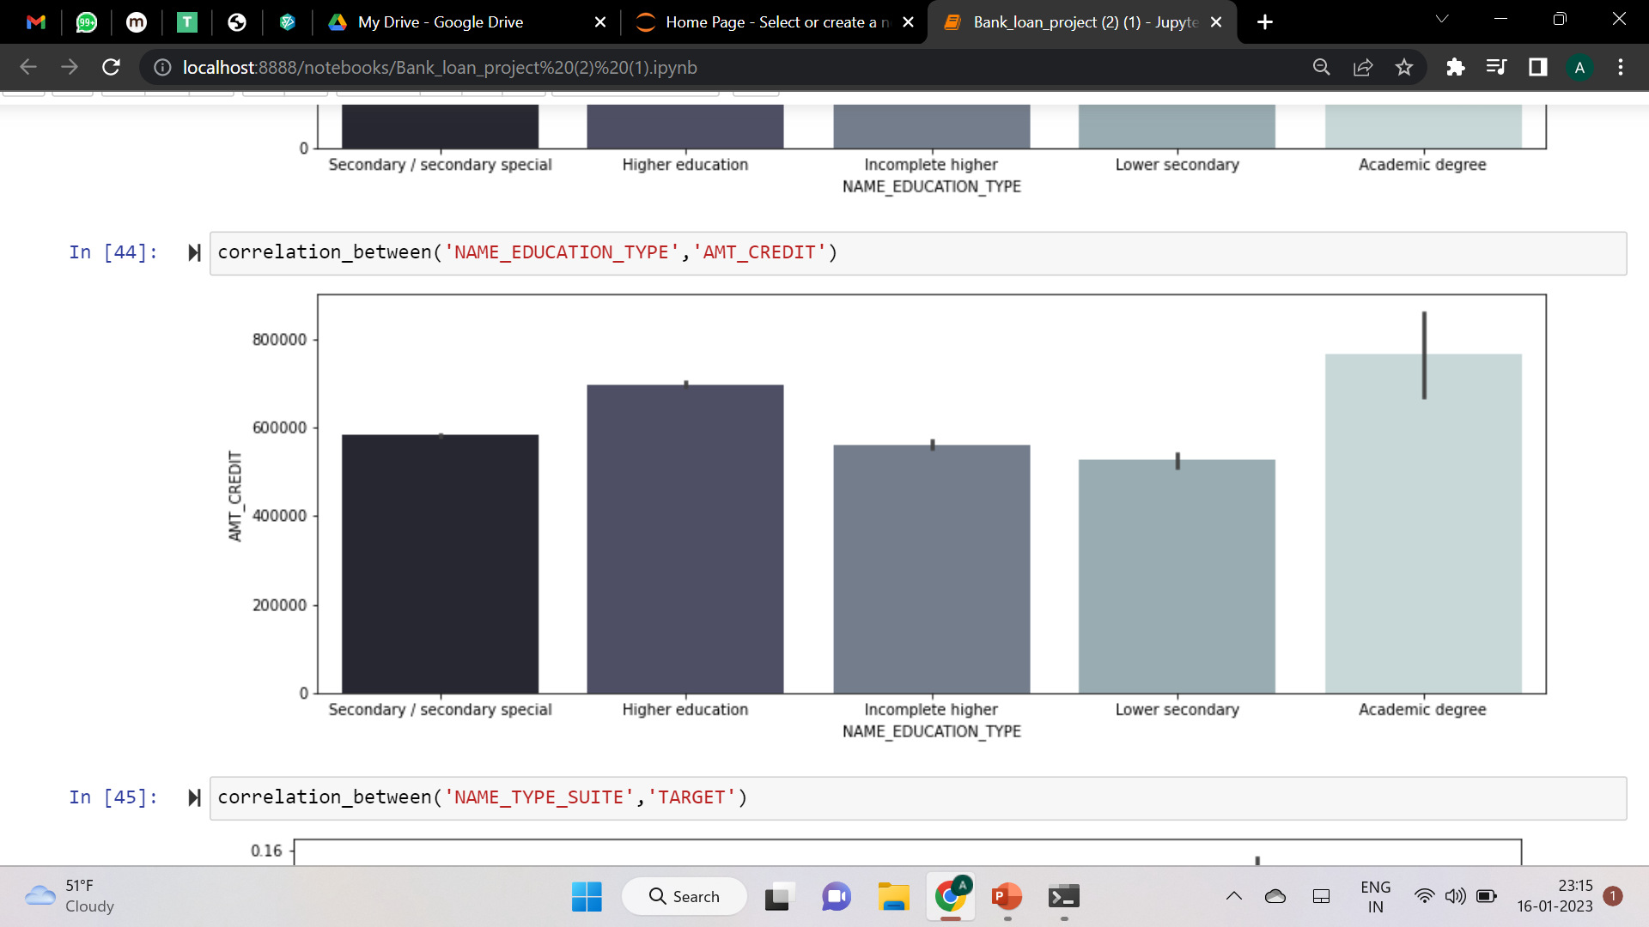
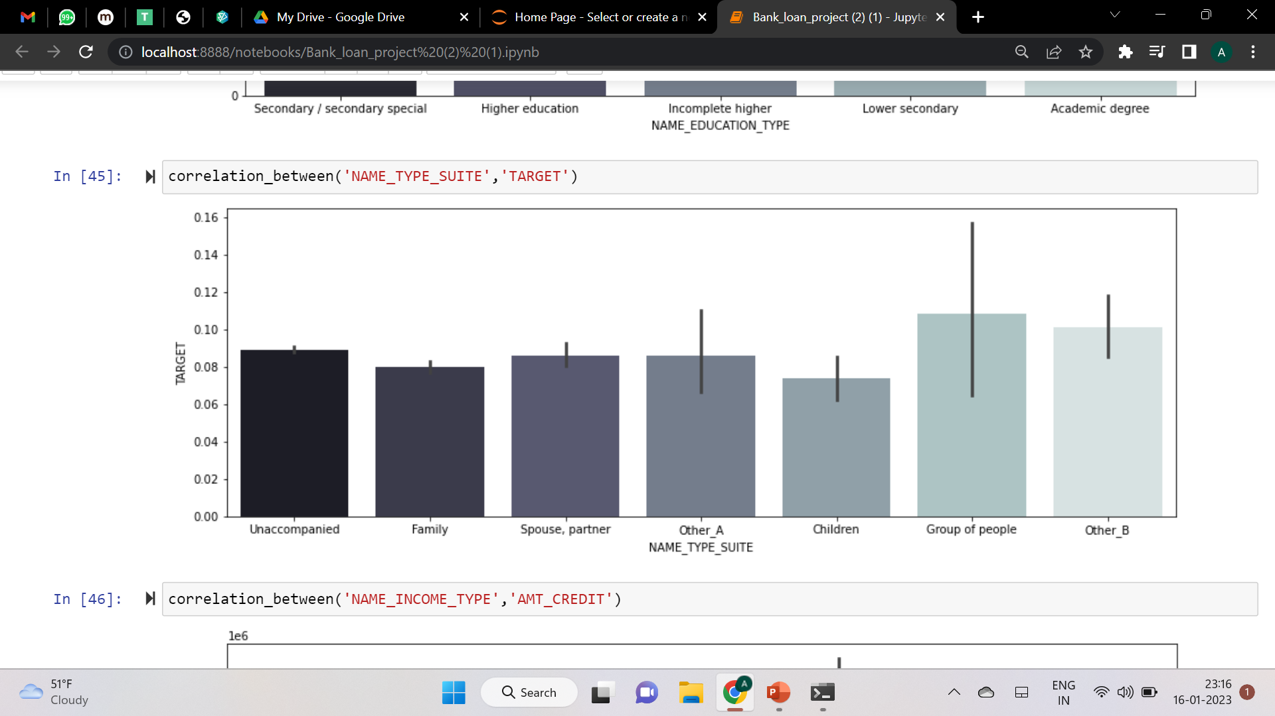

Slide 28
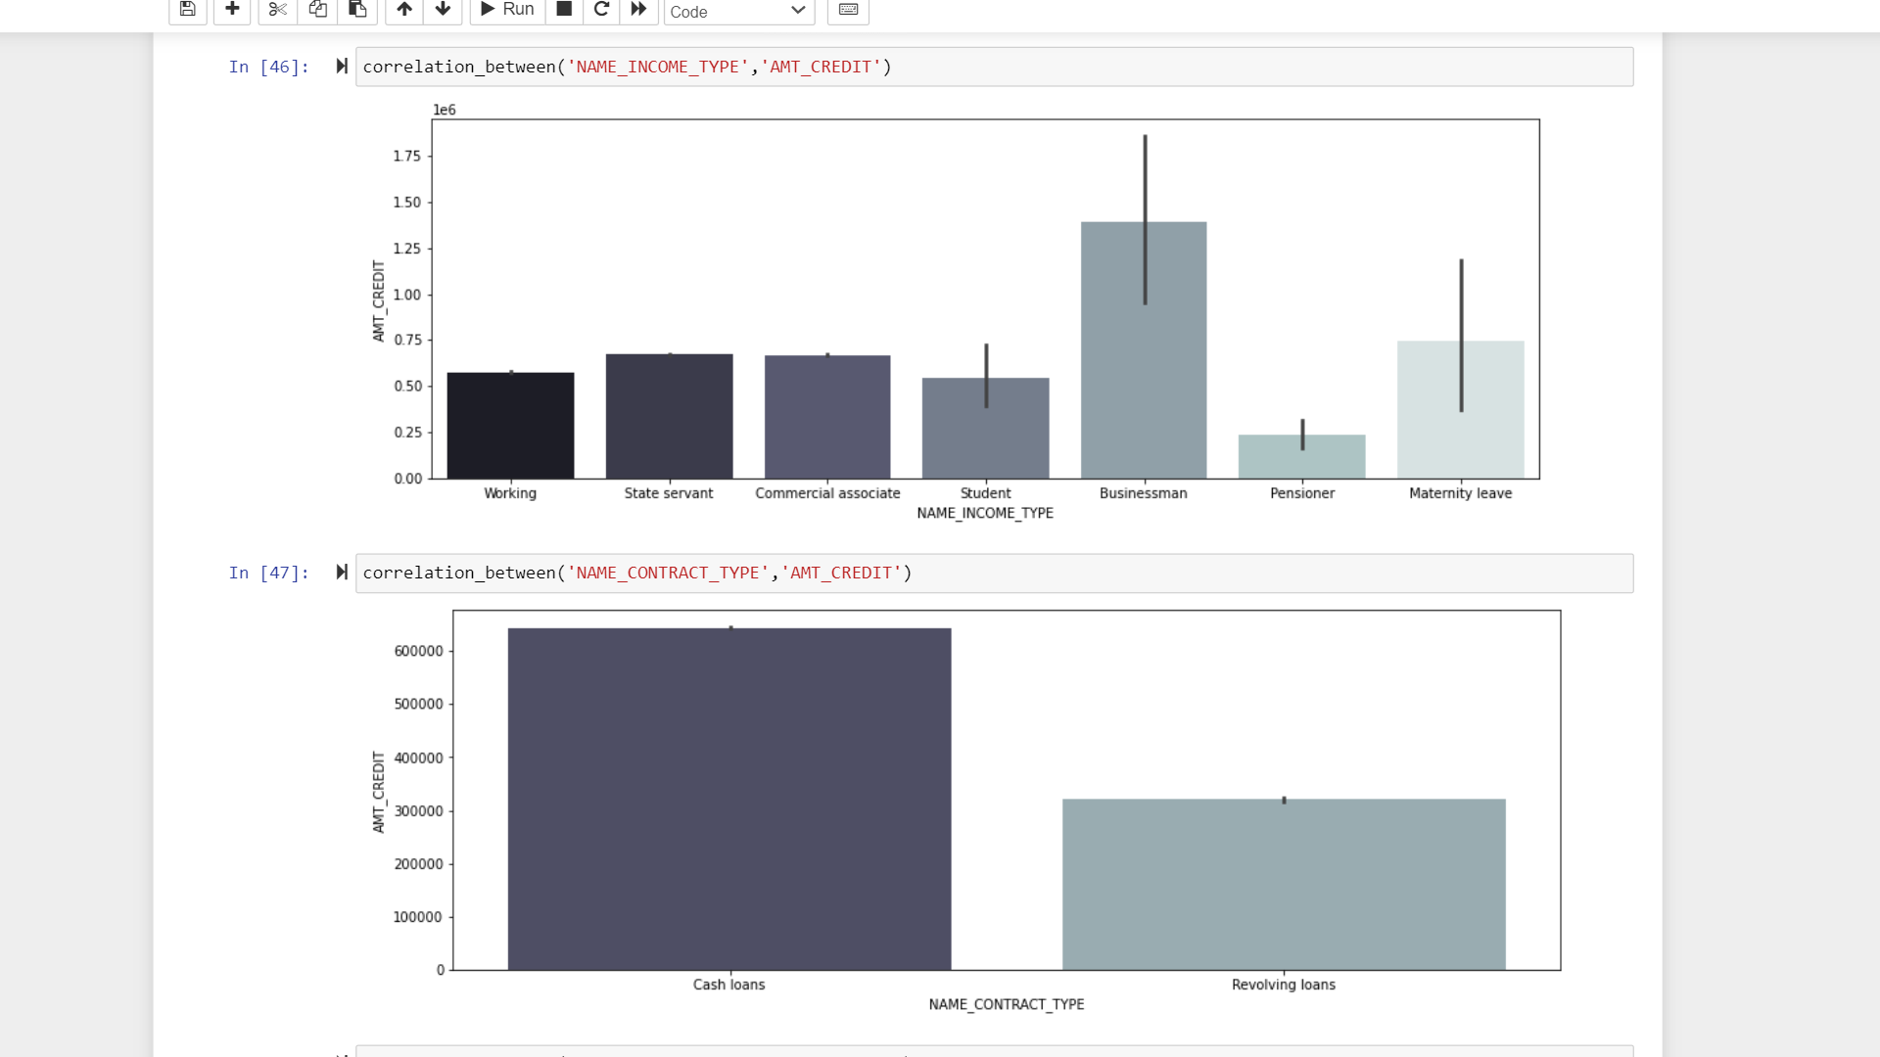

Slide 29
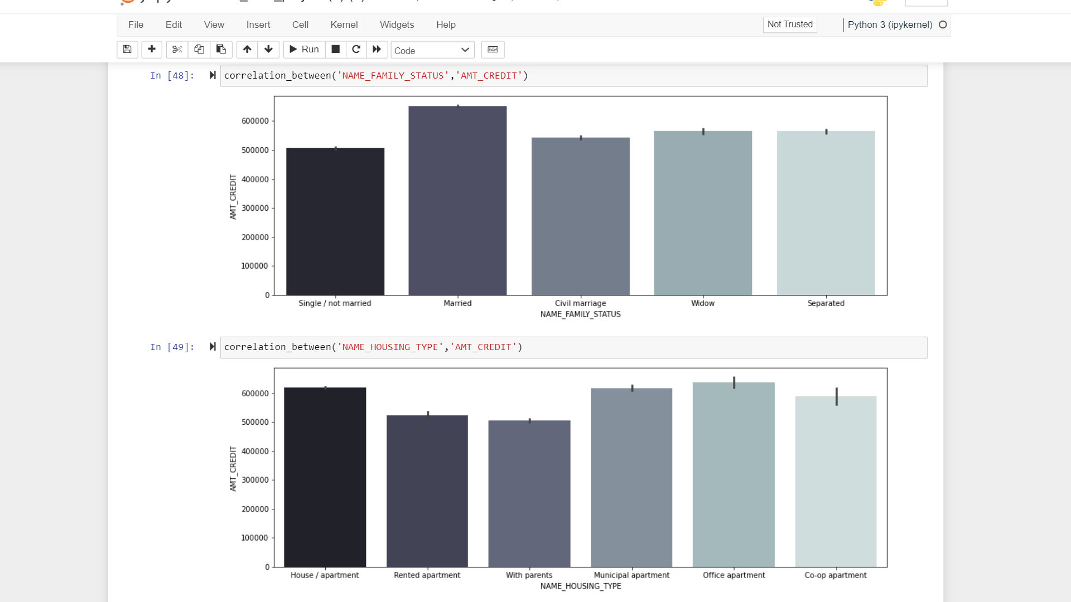

Slide 30
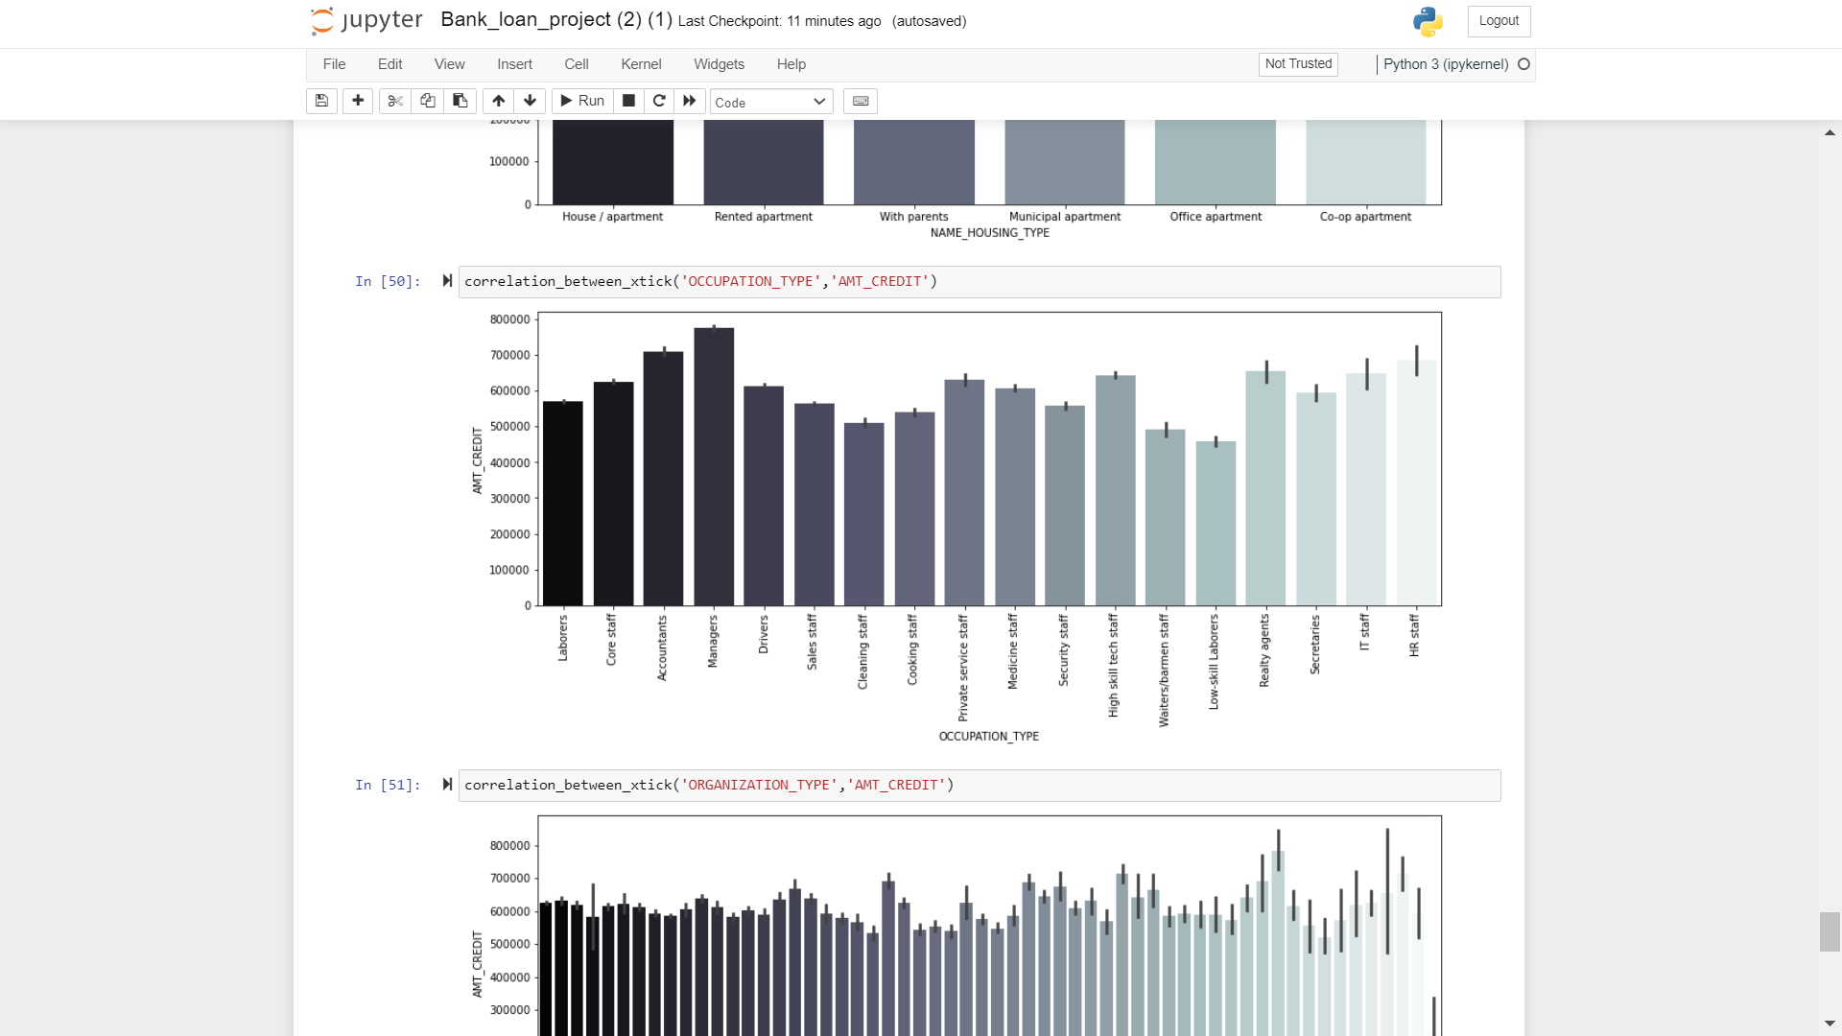
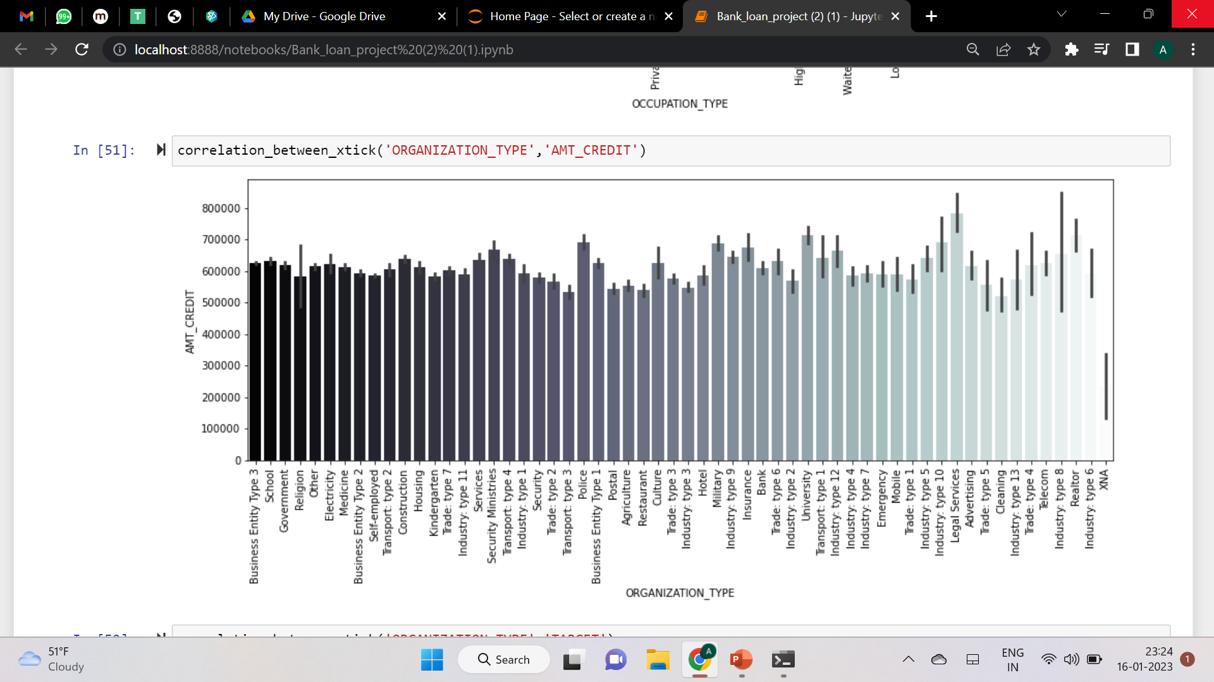

Slide 31
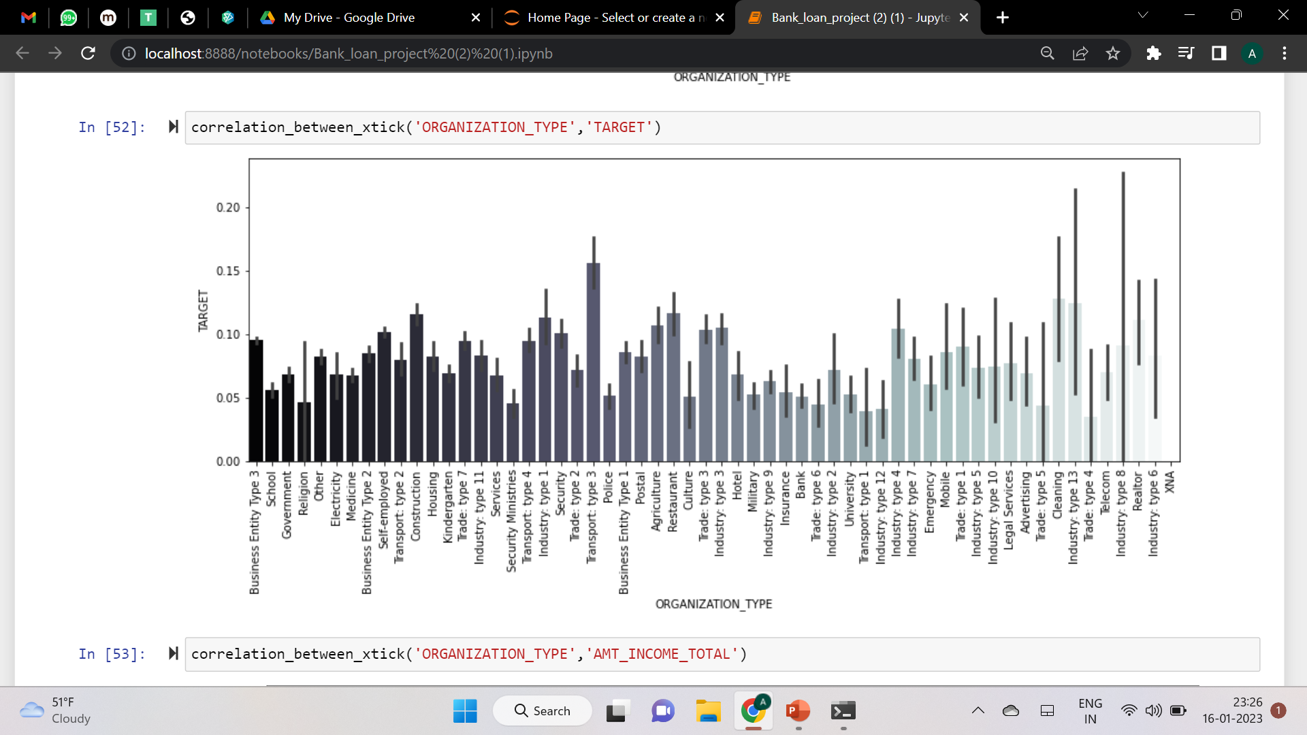

Slide 32
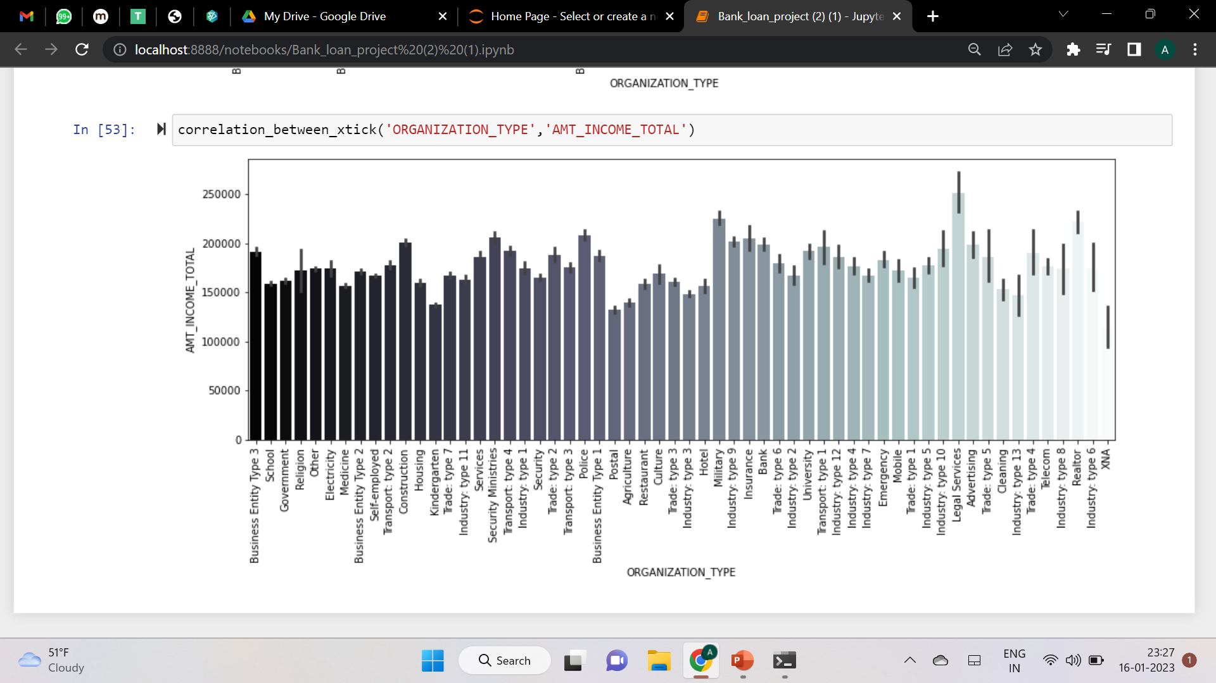

Slide 33
Include visualizations and summarize the most important results in the presentation. You are free to choose the graphs which explain the numerical/categorical variables. Insights should explain why the variable is important for differentiating the clients with payment difficulties from all other cases.
We have analyzed the datasets, and we have given all the outputs in the above ppt so by this bank can think about whether the bank will get the money back from the customers or not.
NAME_EDUCATION_TYPE: Academic degree has fewer defaults.
NAME_INCOME_TYPE: Students and Businessmen have no defaults.
REGION_RATING_CLIENT: RATING 1 is safer.
ORGANIZATION_TYPE: Clients with Trade Type 4 and 5 and Industry type 8 have defaulted less than 3%
DAYS_BIRTH: People above the age of 50 have a low probability of default
DAYS_EMPLOYED: Clients with 40+ years of experience having less than 1% default rate
AMT_INCOME_TOTAL: Applicants with Income more than 700,000 are less likely to default
NAME_CASH_LOAN_PURPOSE: Loans bought for Hobby, Buying a garage are being repaid mostly.
CNT_CHILDREN: People with zero to two children tend to repay the loans

Slide 34
Summary
After performing the analysis, we have reached the decision that whether the client will repay the loan or not.
Most of the people who are facing problems while repayment is a laborers.
People who are in Secondary and Special education face problems with loan repayment.
The people who are living in a house or in an apartment are facing difficulty with loan repayment.
People opting for cash loan faces difficulty in repayment.

Slide 35

Thank YOU
Ayush Saxena

